Slide 1
Enigma Encryption Game
Team Illuminati:
Ashwini Chaudhari
Parshi Srinidhi
Manojna Sistla
Nikitha Kakani
Divya Sirikonda
Prudhvi Thota

Slide 2
Objectives & Features
Multi user password authentication
Multi Level Game Play
Encrypted Math Game
Multi Level Score and Timing
Winner Profile from the multiple players

Slide 3
Game Play
User ID
Password
Level 1
Level 2
Level 3
Winner
User enters his/her ID
User enters his/her corresponding password
Training Level without score or timer.
Score and 90 secs of timing given to identify the encrypted random numbers
Last level with 60s time and score features where player has to sum two encrypted numbers.
From all the users, winner is declared by the highest score from each level.

Slide 4
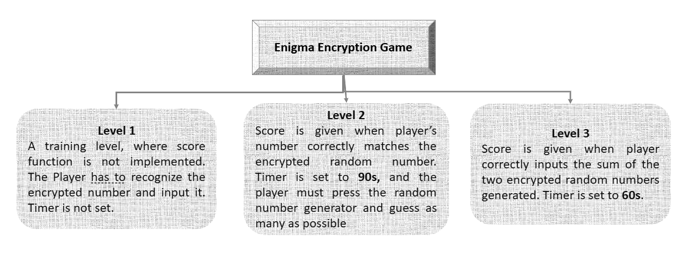
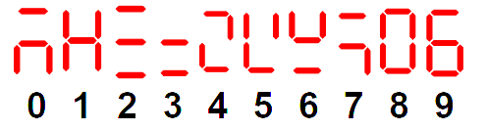
Levels

Slide 5
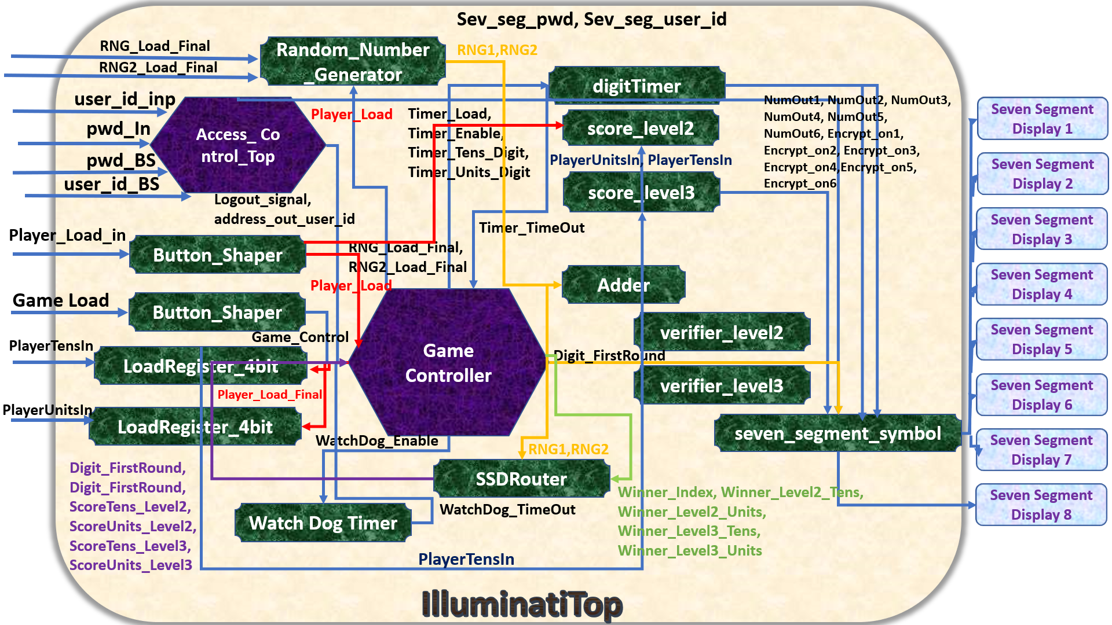

Module Descriptions
Modules & Implementation
Enigma | Team Illuminati

Slide 6
Video Demonstration
https://drive.google.com/open?id=1n8acv5HuYbqP9-FvaGrLw5fWjZFxIcQ5
https://drive.google.com/open?id=1jtpReTOsdeBM9EWggBVEyhCQoG6yx7oG
https://drive.google.com/open?id=1xq9Ijhx7xhxoLfvpW0-VJbeU5U9Ikiay

Slide 7
Challenges
SSD Router: It’s a module that allows a way of routing all outputs to the correct seven segment displays and manage multiple displays for different levels.
Encryption ON/OFF: This was added to the seven segment displays as a way of choosing to display the encrypted number or the original number.
1
3
2
Score Clear: The score and timer had to be cleared for every log out of the user.
4
Random Number Loads: The two random numbers had to be generated by the same button push for the third level.

Slide 8
Incomplete Objectives
RAM storage for scores and winner profiles.
Include a feature for replacing new score for a user if it was higher than the previous score.
If user fails to correctly guess answers three times in level 2 & 3, another random number will automatically be generated.

Slide 9
Future Scope
If the score is a tie for multiple users, display all their user IDs
Including a scoreboard feature for all users’ score display.

Slide 10
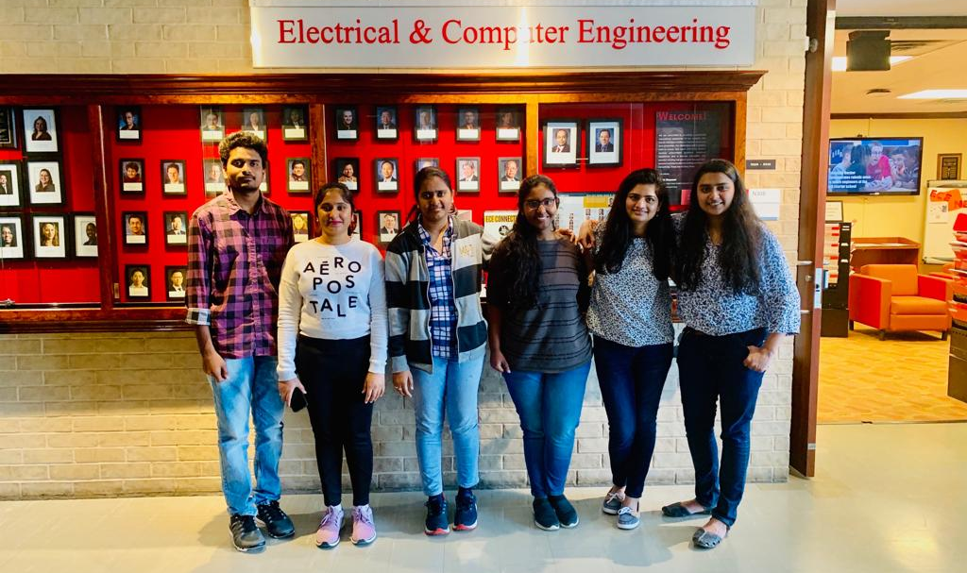
Thank you.

